Slide 1
Informatics Tools for Biodiversity Data Conversion
Kittinan Ponkaew
VisLab, Osaka
7/24/2013

Slide 2
Week 4 Progress
Script for paleo data is working but there are some problems, which I have yet to fix
Restored the database and everything had to be set up again
Tried to clean up Herps database

Slide 3
Plans for Week 5
Finish paleo script and test it with Specify
Hopefully get the Herps database done
Update Specify database

Slide 4
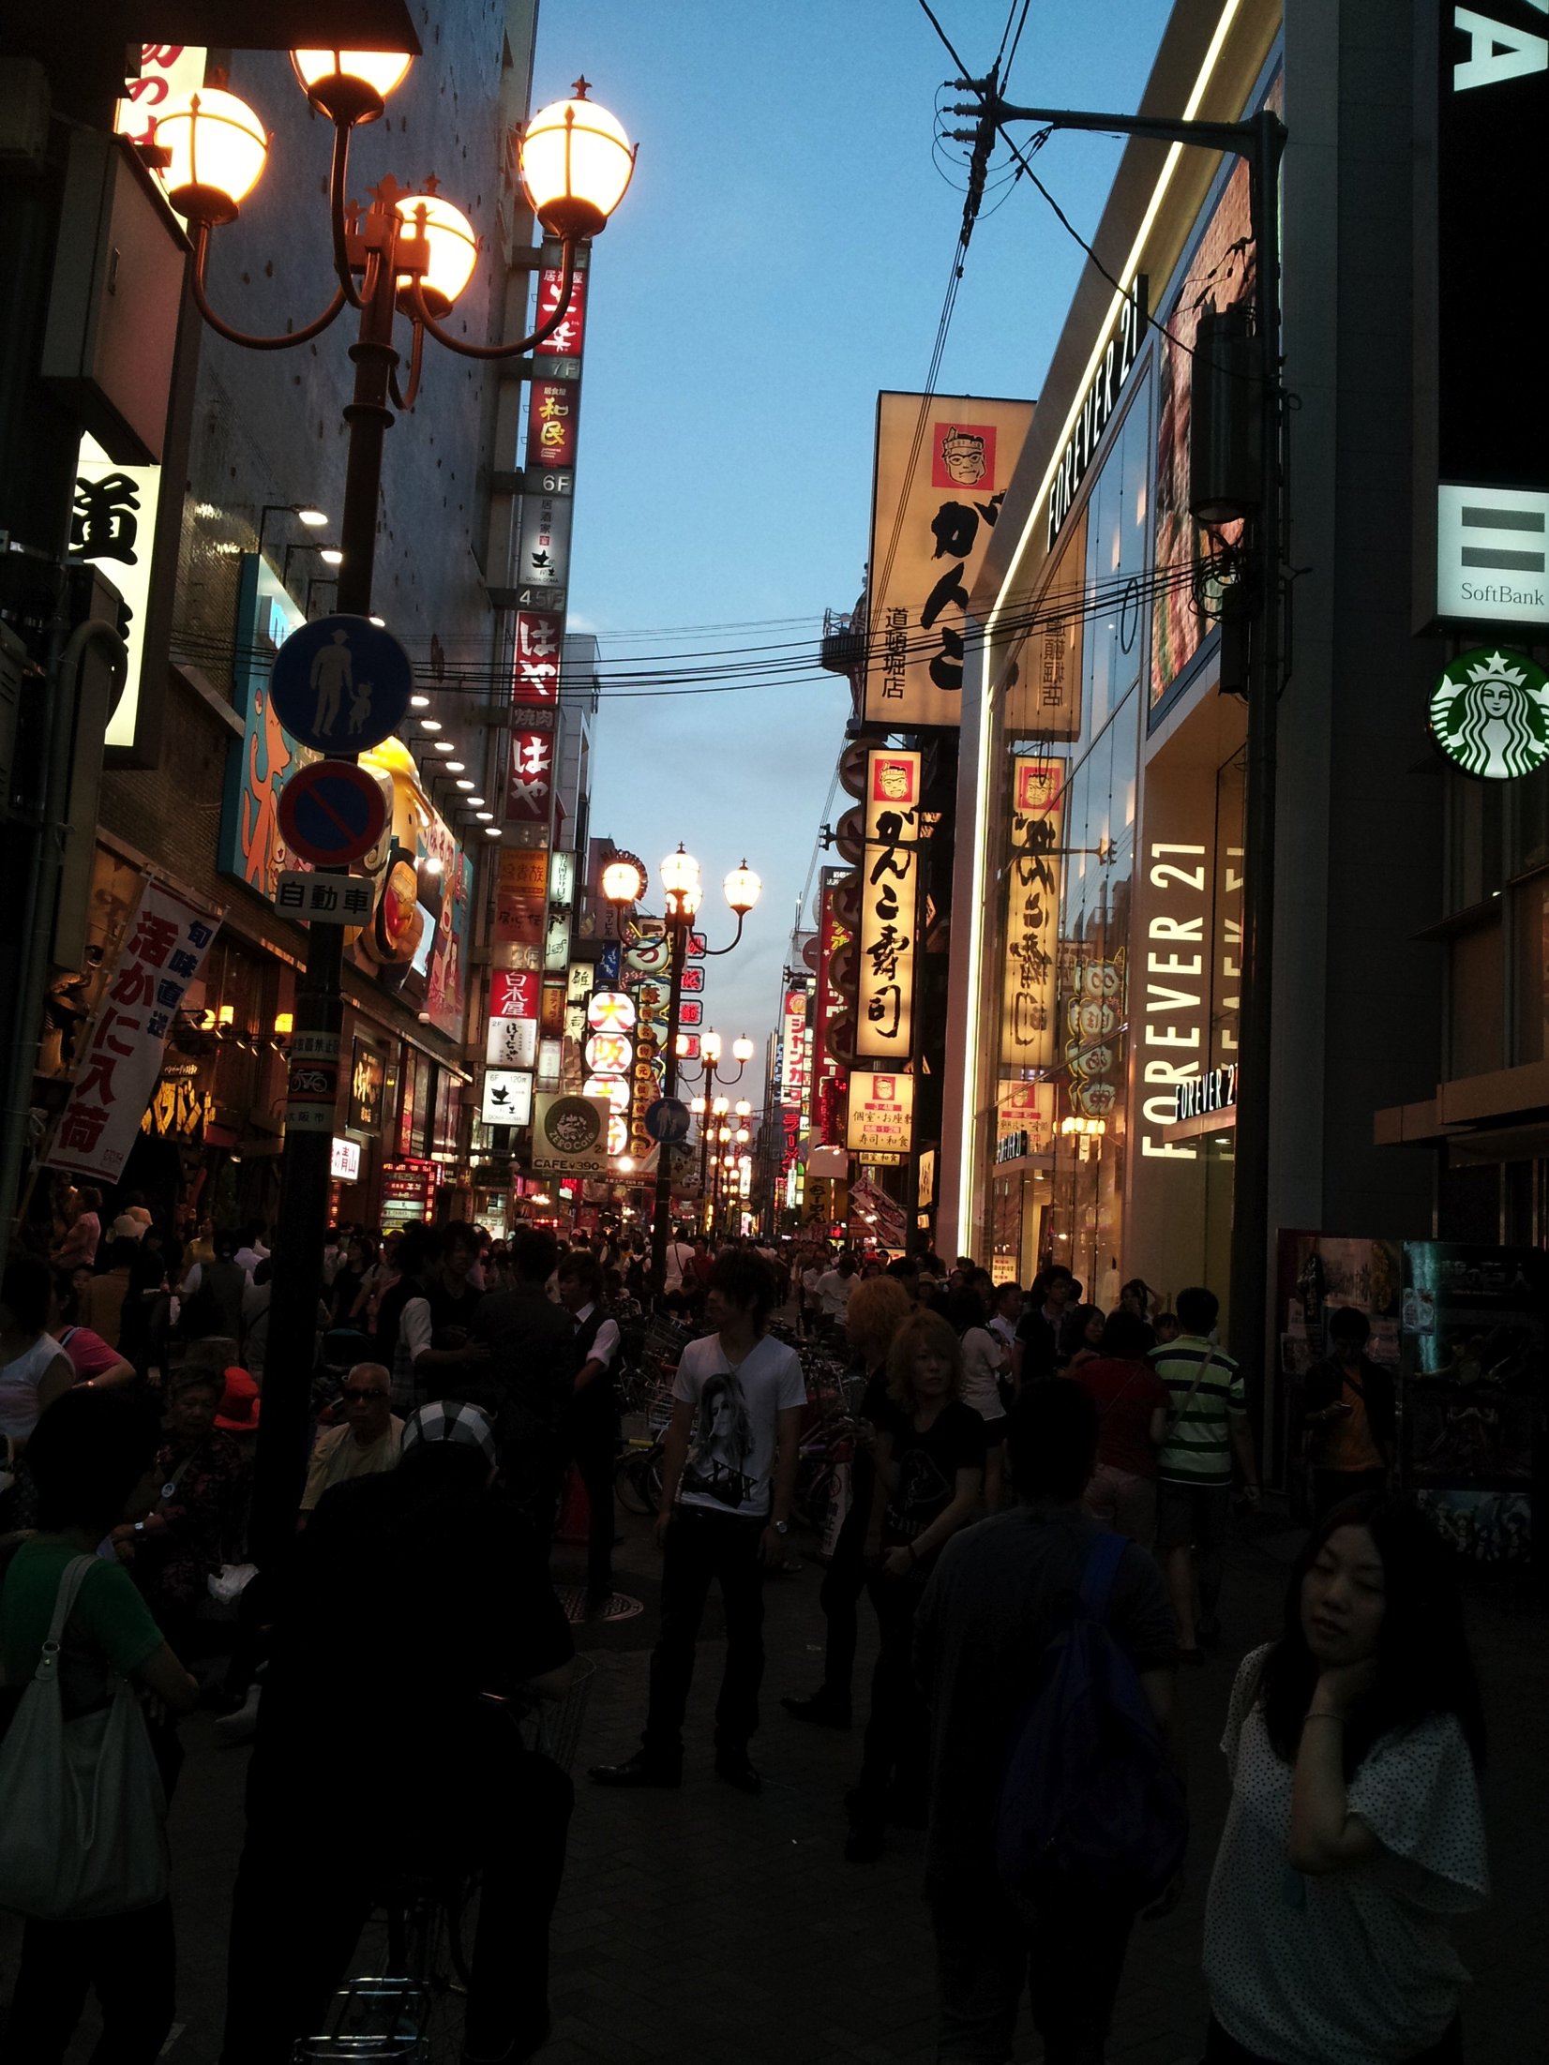
Cultural Exploration
There’s always lots of people in
Namba, especially at night.

Slide 5

Cultural Exploration 2
Festival along the river in Namba.

Slide 6
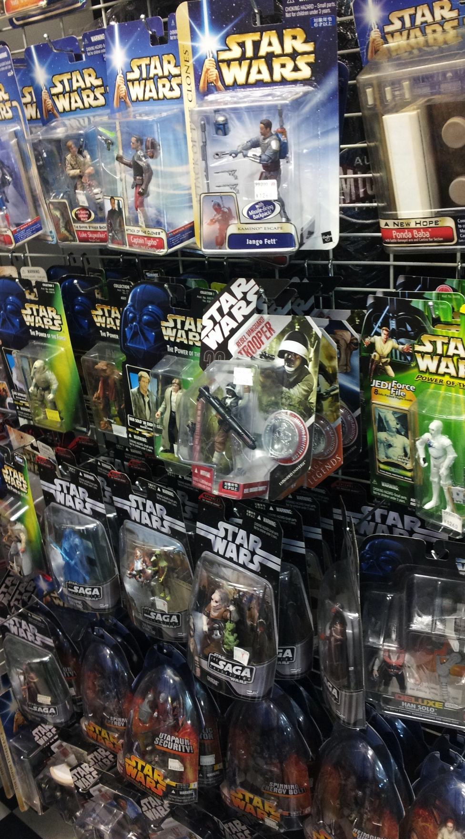
Cultural Exploration 3
Star Wars is popular, even in Japan.

Slide 7
Acknowledgement
Dr. Jason Haga
Dr. Shinji Shimojo
PRIME
NICT
Balboa Park Online Collaboration
PRIME alumna Haley Hunter-Zinck
NSF

